Slide 1
Informatica

Slide 2
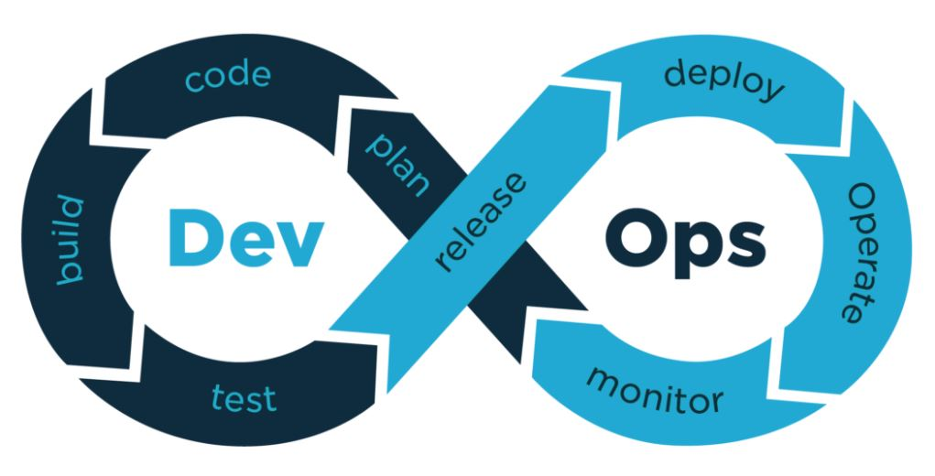
What is DevOps ?
DevOps word is a combination of two words one is Development and other is Operations. It is neither an application nor a tool; instead, it is just a culture to promote development and Operation process collaboratively. As a result of DevOps implementation, the speed to deliver applications and services has increased.
DevOps enables organizations to serve their customers strongly and better in the market. In other words, we can say that DevOps is the process of alignment of IT and development operations with better and improved communication.

Slide 3
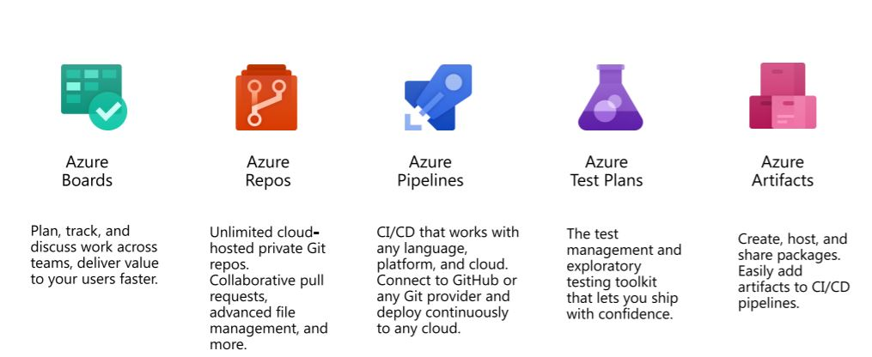
INTRODUCING AZURE DEVOPS

Slide 4
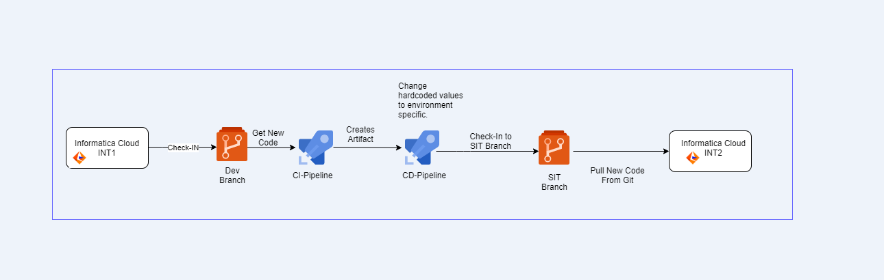
DevOps Workflow

Slide 5
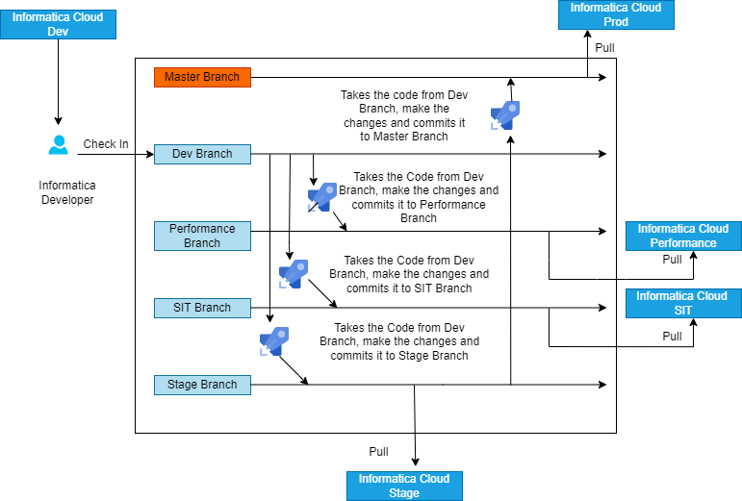
Branching Strategy

Slide 6
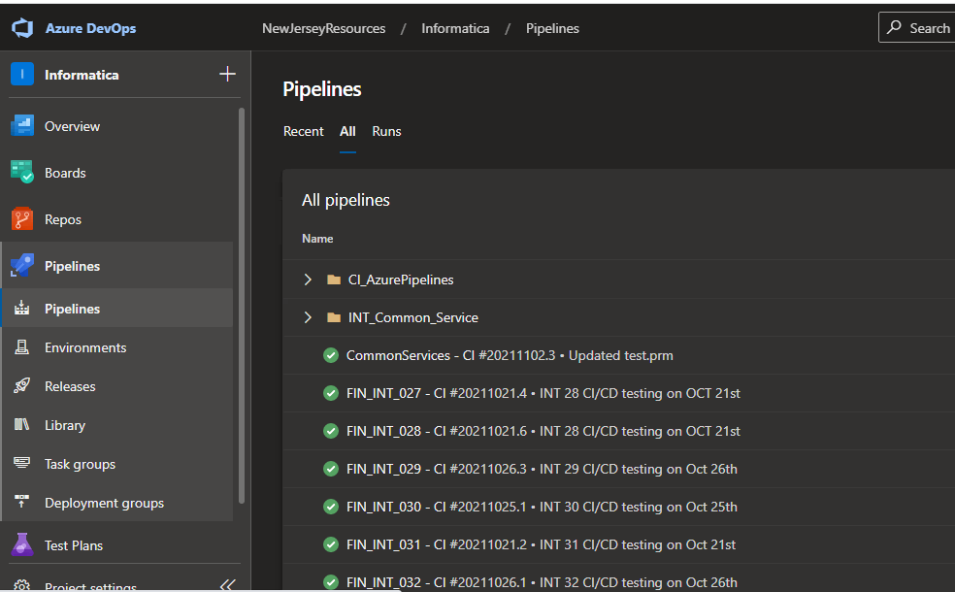
CI/CD Pipelines in Informatica Project
Types of build (Continuous Integration) pipelines
46 separate CI Pipelines, one for each Integration.
6 CI Pipelines for Common Services.
Types of Release (Continuous Deployment) pipelines
Each Build pipeline has a corresponding Release
pipeline with the following stages.
Dev
Performance
QA/SIT
Stage
Production

Slide 7
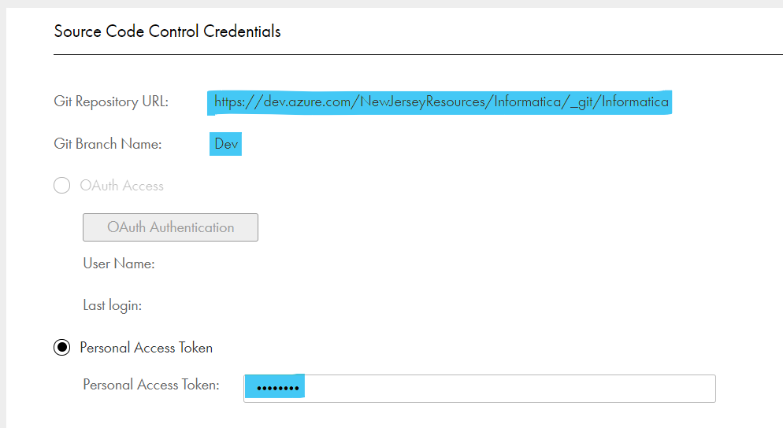
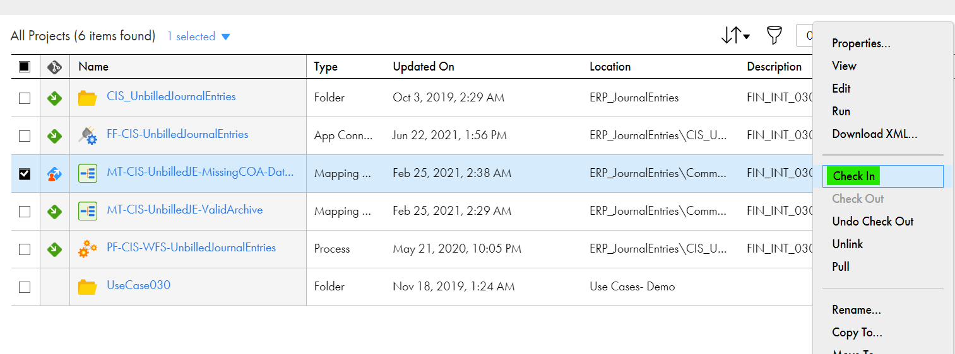
The Checkin/Checkout Process from Informatica
The Developer must enable version control and configure Informatica with Azure Repos (i.e., Git) by providing the PAT (Personal Access Token) and URL with the Azure Repo Branch Name in order to push and pull the code from the Git.
The Developer has to check-in/checkout the asset of any particular integration from the Informatica Dev environment in order to push the code into the Azure repository with a meaningful Commit Message.

Slide 8
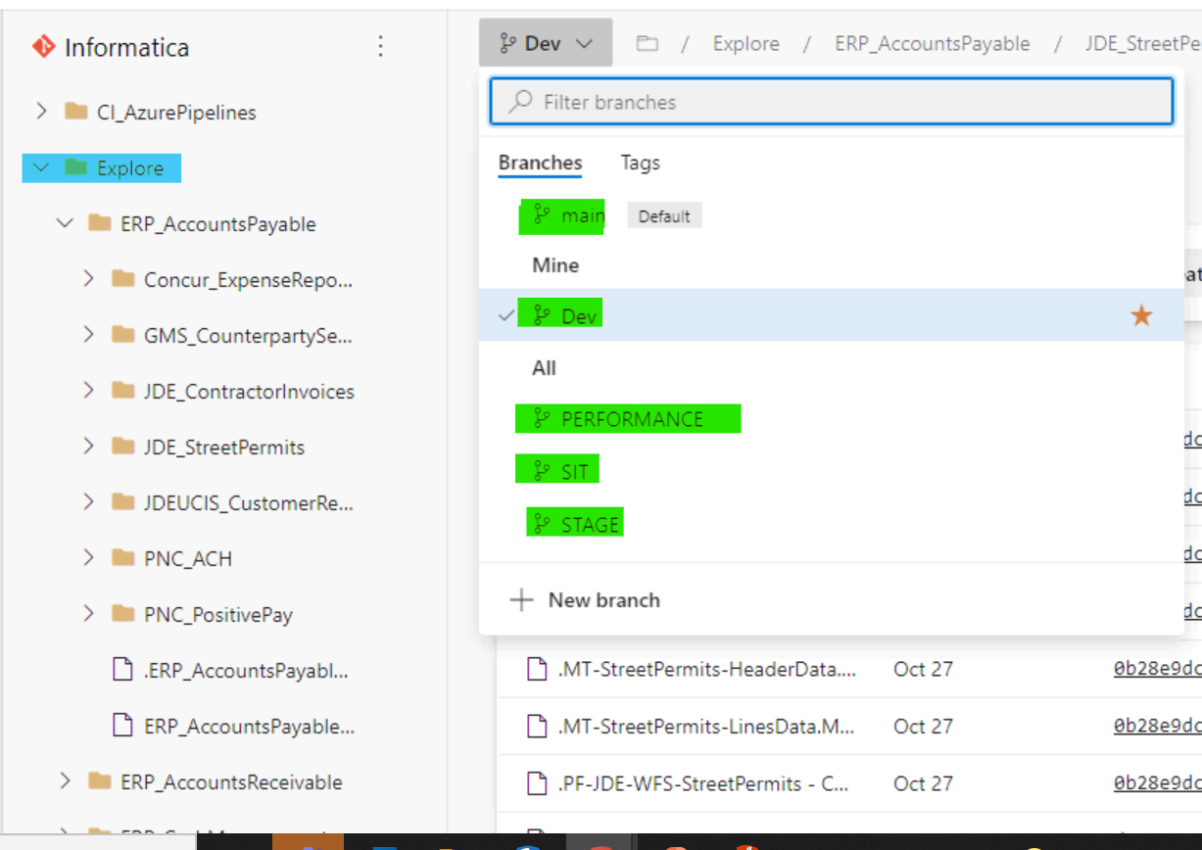
The Commit To Azure Repository
As the Developer will check in the asset from Informatica to Azure Repository , a latest commit can be seen in the same folder structure that was maintained in the Informatica for eg -Explore/ERP_AccountsPayable/JDE_StreetPermits. The Repository will have 6 Branches.
Main
Dev
Performance
SIT
STAGE
PROD
The code will always be pushed into the Dev Branch Initially which will Trigger the CI Pipeline for the respective Integration which was Checked In.

Slide 9
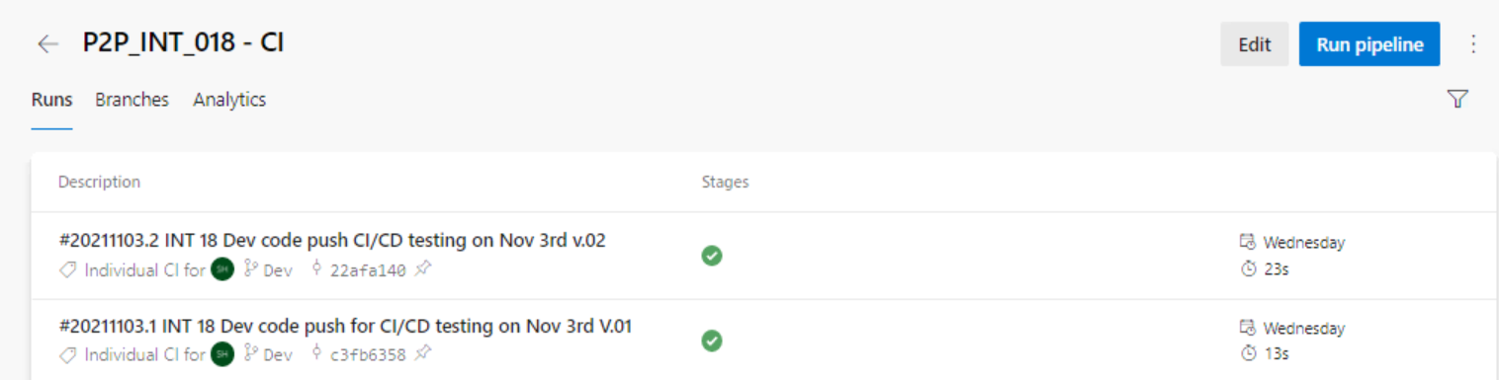
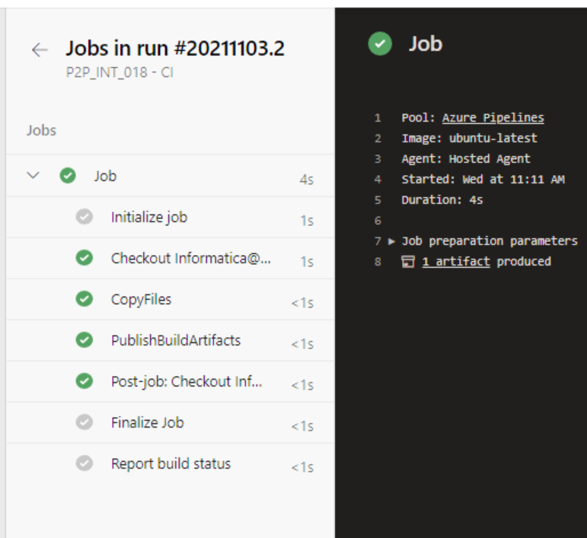
CI Build Pipeline
This Pipeline performs following tasks:
Triggering – The Pipeline Triggers whenever there is new commit in the repository. Only the Specific Pipeline will trigger on the basis of the commit.
There are Individual Pipeline for Individual Integration with a meaning full name.
Publish pipeline Artifact – This task is used in a build pipeline to publish build artifacts to Azure Pipelines, TFS, or a file share. In this task we are publishing the PowerShell Script that will be taken from the Repository and will be published as an artifact. Then this artifact will be consumed by respective release pipeline.

Slide 10
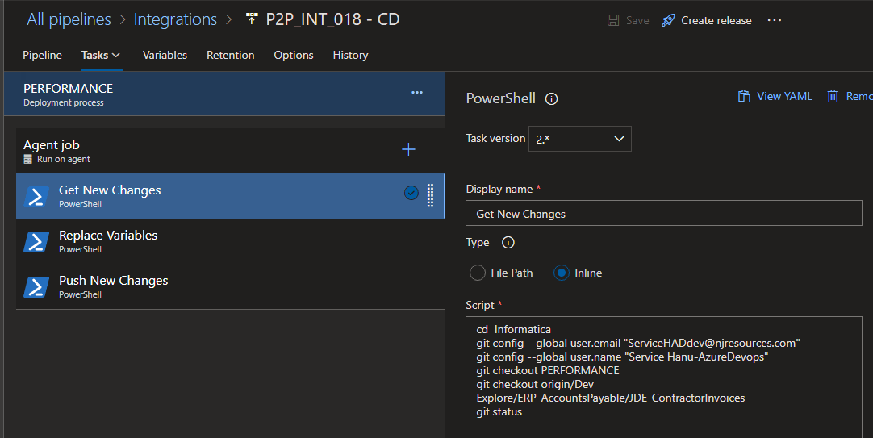
CD Release Pipeline
In Release Pipeline , 3 Tasks are defined at every
Stage
Get New Changes
In this Task we are checking out to the respective Branch to see the log of the changes done
Replace Variables
In this task we are calling the script which was passed as an artifact and replace the hardcoded values
Push New Changes
In this Task we are Pushing the new changes to the other branches with the changes hardcoded values based on the environment.

Slide 11
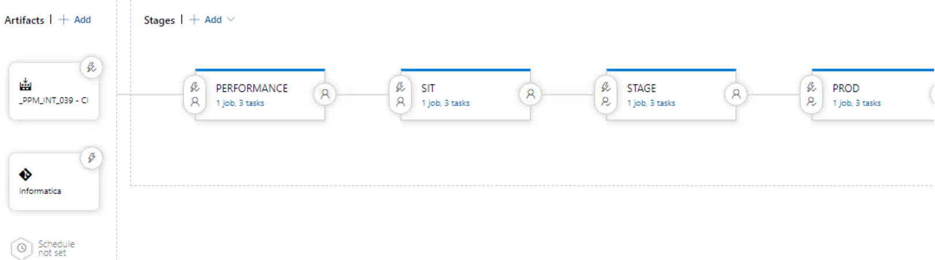
CD Release Pipeline with Stages
This pipeline is auto triggered whenever the build pipeline is successful
Instead of Approvers we can integrate ServiceNow Change Management solution
Release pipeline will deploy to Different environment but before deploying to Higher Environments we have added APPROVERS.
So that without verification from the Approvers we will not be able to deploy it further(i.e., only Approvers can Release it in Higher Environments).

Slide 12
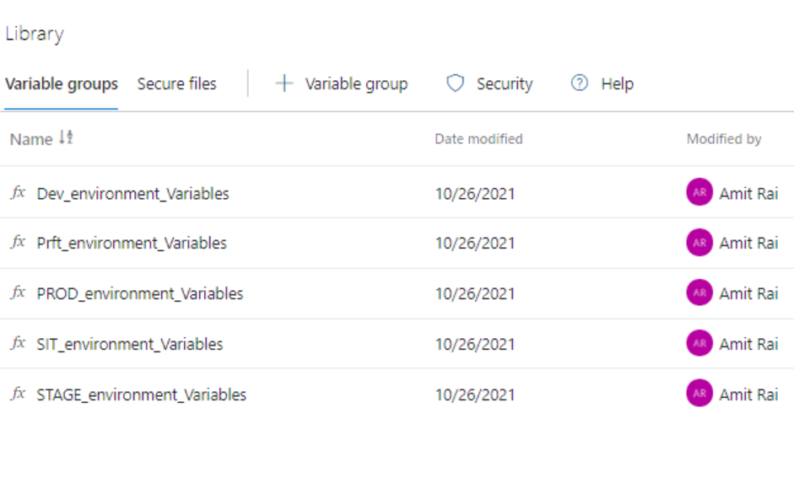
Variables Groups
Use a variable group to store values that you want to control and make available across multiple pipelines and multiple stages. We can also use variable groups to store secrets and other values that might need to be passed into our application.
Variable groups are defined and managed in the Library page under Pipelines.
These variable groups will be used in respective DEV, PRFT, SIT,STAGE and PROD stage Release Pipeline.

Slide 13
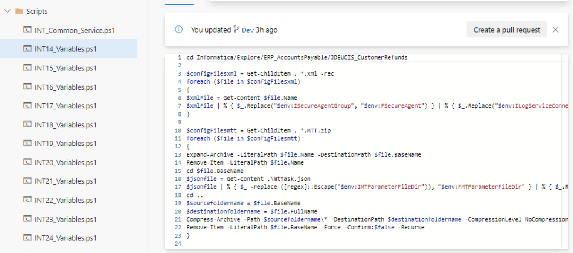
Scripts
We have PowerShell Scripts which is specific to each Integration and will be Changing the Hardcoded values. These scripts will take the Values of the changing parameters from the Variables created inside the variable group under library section and if the values are not in a synchronized fashion, then we have pipeline variables which will overwrite the variables in the library and work accordingly. These scripts are located in Dev Branch and will be passed as an artifact from the CI Pipeline.

Slide 14
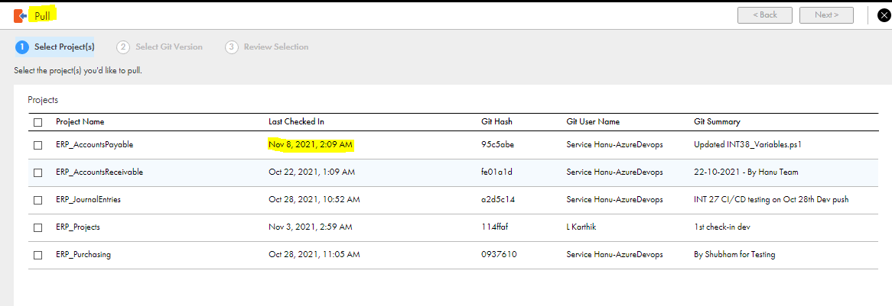
Pull from Azure Repository Branches
In order to migrate the Integration, Informatica Developer has to PULL the respective Integration or asset from the Informatica Environment using “PULL From Git” from any branch which will also show the git log and Summary and Asset will be migrated with the changed values.

Slide 15
Thankyou

